Slide 1
December 2024
Boca-ECGI
Disqualifying Managerial Misconduct
in Corporate Bankruptcy
Donghyun Kang
Erasmus School of Economics
S. Lakshmi Naaraayanan
London Business School
Kasper Meisner Nielsen
Copenhagen Business School
Danish Finance Institute

Slide 2
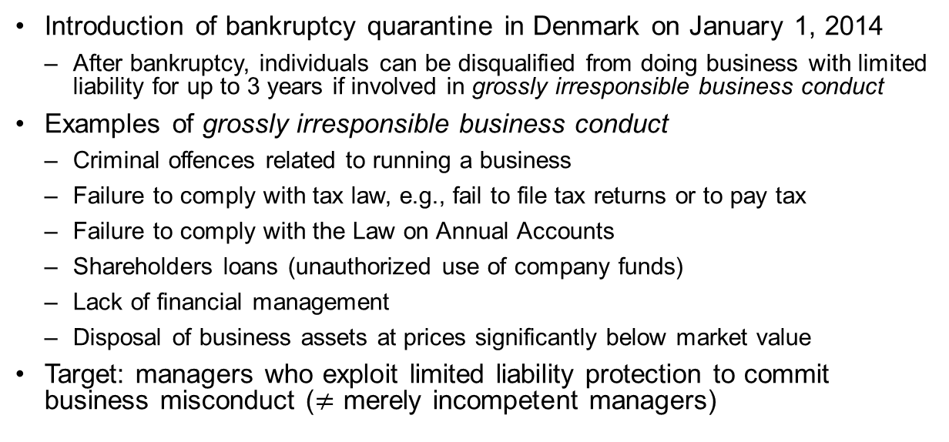
Introduction
Introduction of bankruptcy quarantine in Denmark on January 1, 2014
After bankruptcy, individuals can be disqualified from doing business with limited liability for up to 3 years if involved in grossly irresponsible business conduct
Examples of grossly irresponsible business conduct
Criminal offences related to running a business
Failure to comply with tax law, e.g., fail to file tax returns or to pay tax
Failure to comply with the Law on Annual Accounts
Shareholders loans (unauthorized use of company funds)
Lack of financial management
Disposal of business assets at prices significantly below market value
Target: managers who exploit limited liability protection to commit business misconduct ($≠$ merely incompetent managers)
Notes:
Loans: "Unauthorized loans or advances from the company to its shareholders"
Rather than any bankrupts, this is Targeting at those who exploit the protection of limited liability and bankruptcy law to commit irresponsible business conduct or outright fraud

Slide 3
Motivation
Bankruptcy quarantines or disqualification of individuals from management/key positions is a common feature across countries
For engaging in misconduct/fraud in the period leading up to bankruptcy
United Kingdom (1986) bans such individuals for being managers of limited liability companies for 2 to 15 years
United States (2002), Sarbanes-Oxley Act allows the SEC to ban individuals from being a director of a public company if a bankrupt company violates securities law
Other examples: Germany (1980), Norway (1984), Australia (2001), China (2006), India (2013), Ireland, Sweden (2014), Netherlands (2016) …
→ Plenty of case evidence, but little or no systematic evidence on the effectiveness
Notes:
Throughout this paper: interchangeably use quarantine and disqualification.
Sweden (2014) bans individuals from being managers, founders or majority owners of LLC for 3 to 10 years for “grossly irresponsible business conduct”

Slide 4
Research Question
How effective are bankruptcy disqualifications?
Direct Effects
Managerial resurrection rates after the quarantine expires
Personal economic costs
Strategic Responses
Strawman (front man/pawn) appointments
Family member involvement
Broader Impact
Future bankruptcies/crimes
Changes in managerial labor pool

Slide 5
What we do
Use data from Denmark that identifies bankruptcy quarantined managers to examine the effect and personal cost of quarantines
Compare outcomes to a control group of bankrupt, but not quarantined managers in the same year & court
This version relies on newspaper articles and court documents to identify 58 bankruptcy quarantined managers
Quarantined managers from six regional courts in 2017
Comparable setting to countries that publish the list of disqualified managers (e.g., Norway, Sweden, Australia)
Next version: Full register of quarantined managers from the Danish Business Authorities & Department of Justice
Notes:
69 managers: come from the universe of quarantined managers from the three regional courts

Slide 6
Main findings
Low incidence of resurrections – around 15% are holding a managerial position 5 years after bankruptcy
Strawman (front man/pawn) appointments occur
Likelihood that family members hold a managerial position increases
Personal costs are large for quarantined individuals – future personal income is around 20% lower, large effect on assets and liabilities, but small effect on net wealth
Lower incidence of future bankruptcies and crimes after quarantine
Changes in the managerial labor pool, indicative of an increasing use of strawman appointments

Slide 7
Data
Central Business Register from the Danish Business Authorities
Information on firms, founders, managers, owners & board members
Information about bankruptcies & liquidations [time series]
Income and wealth data from the Danish Tax Authorities
Income and wealth information about individuals living in Denmark
Criminal register from the National Police of Denmark
Criminal charges and convictions (fine, prison) at the individual level

Slide 8
Institutional details
1. Pre-2014 Regime:
Limited deterrence against managerial misconduct around bankruptcy
Remedies mainly through:
Civil lawsuits by creditors (costly, time-consuming)
Criminal prosecution (only for severe fraud cases)
No restrictions on starting new businesses (even for convicted fraudsters)
2. Post-2014 Regime:
After bankruptcy filing, mandatory investigation by court-appointed liquidators
After investigation, bankruptcy court can disqualify individuals from managerial positions in LLCs for up to 3 years
Notes:
Compared to the pre-quarantine regime, the reform significantly increased the expected cost of committing misconduct that leads to the creditors' losses
No public disclosure requirement
Information available only to authorities
Investors/employers cannot directly access records
(Public access only through specific court requests, as in 2017 media cases)
Disqualification period starts about a year after the initial filing for bankruptcy (11.5 months)
Most managers (85%) are disqualified for 3 years
Average disqualification period is 2.84 years [distribution]

Slide 9
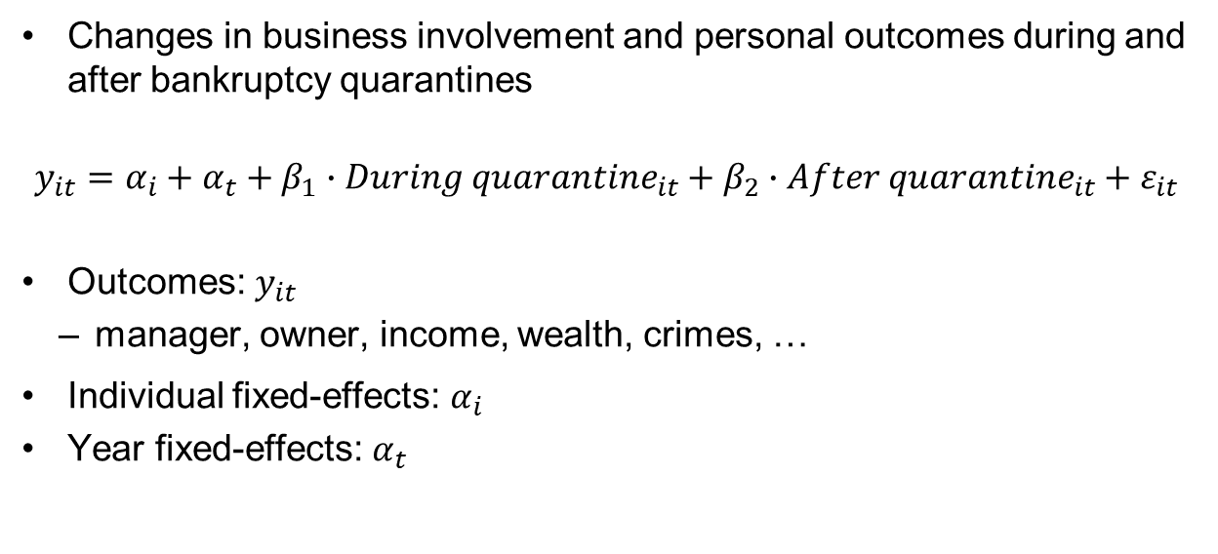
Main specification
Changes in business involvement and personal outcomes during and after bankruptcy quarantines
$$y_{it}=α_{i}+α_{t}+β_{1}∙{During quarantine}_{it}+β_{2}∙{After quarantine}_{it}+ε_{it}$$
Outcomes: $y_{it}$
manager, owner, income, wealth, crimes, …
Individual fixed-effects: $α_{i}$
Year fixed-effects: $α_{t}$

Slide 10
Result

Slide 11
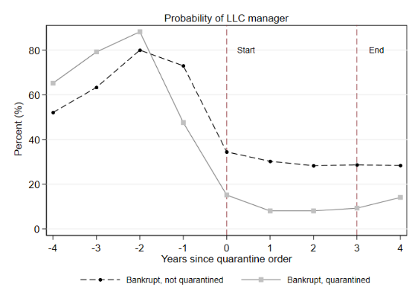
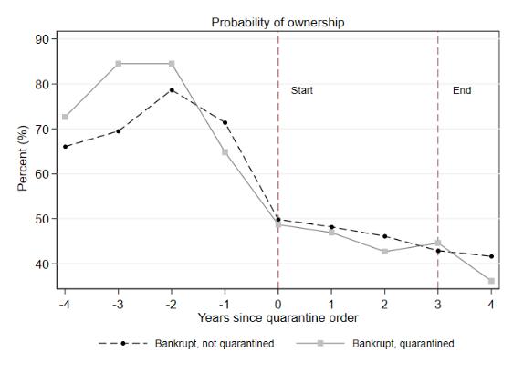
Effect on managerial & ownership positions
Low incidence of managerial comeback even after quarantine expires
Notes:
Descriptive figure.

Slide 12
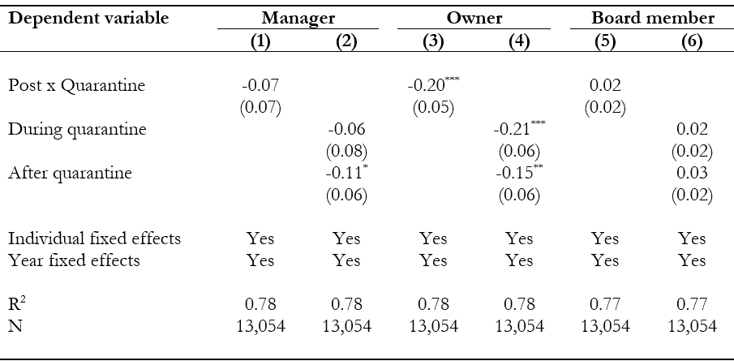
Effect on manager, owners & board member positions

Slide 13
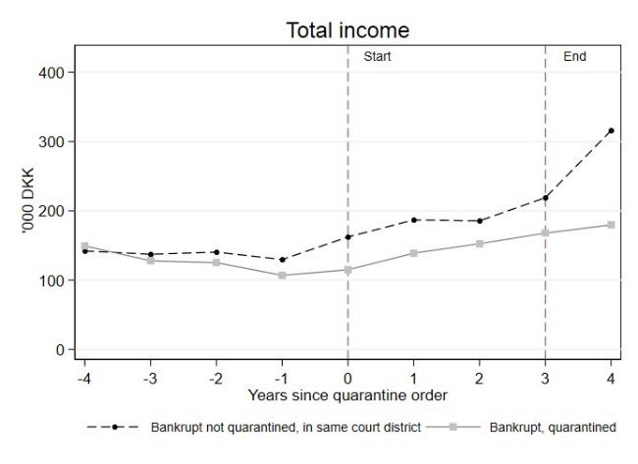
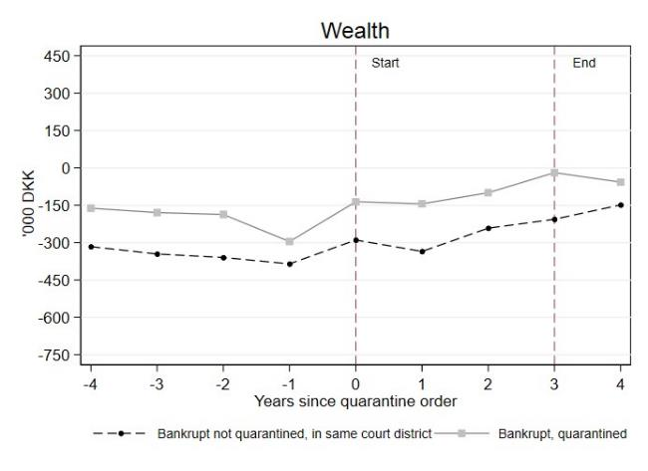
Personal costs: Income & Wealth
20% lower income after quarantines expire

Slide 14
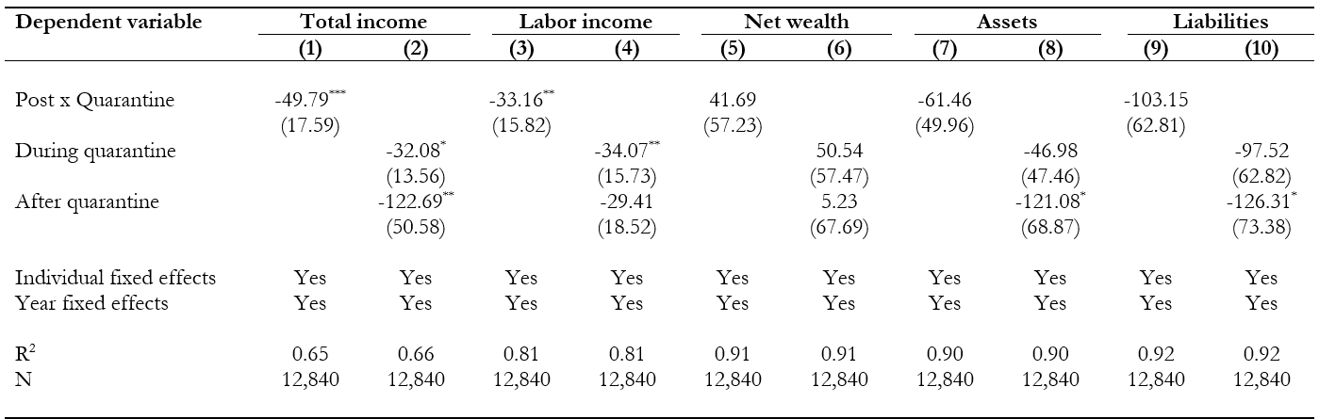
Personal costs: Income & Wealth
Lower income: €10,000 less post-quarantine
Large effect on assets and liabilities, but small effect on net wealth

Slide 15
Effect on personal network
Potential response to disqualification: appoint “straw men”
i.e. managers or owners who are being controlled by the actual owner or controller of the company
By appointing family members as “straw men” managers, disqualified managers avoid being penalized in the future
Why family? Shared financial interest, high level of trust

Slide 16
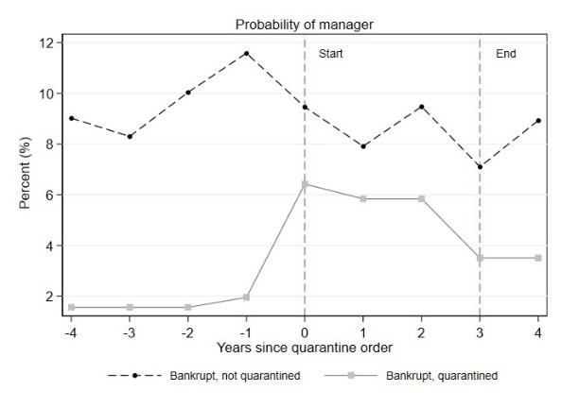
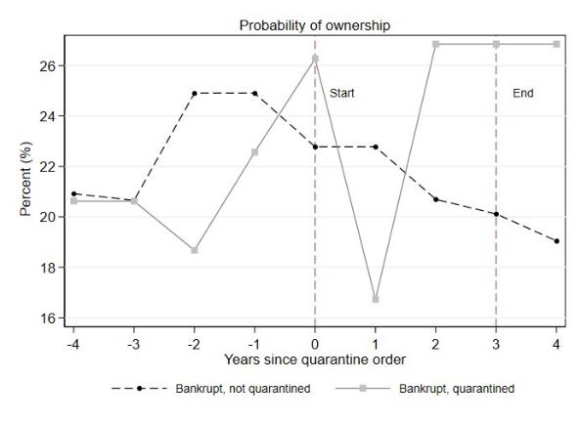
Effect on family appointment: spouse
Spouses of the disqualified manager more likely to be a manager

Slide 17
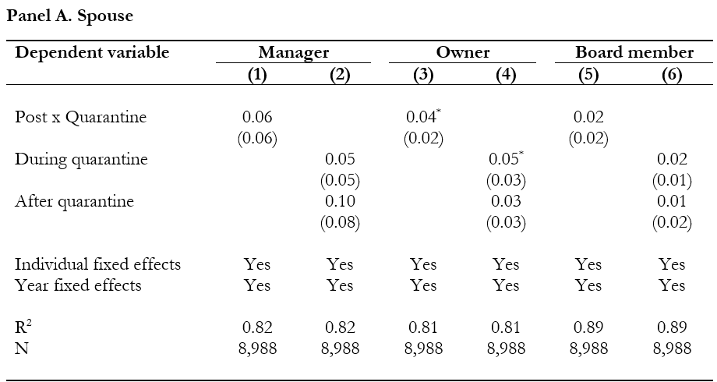
Effect on family appointments: spouse

Slide 18
Effect on deterring misconduct

Slide 19
Effect on future bankruptcies

Slide 20
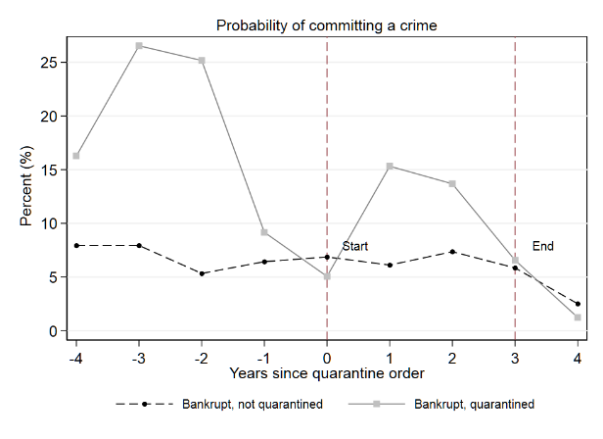
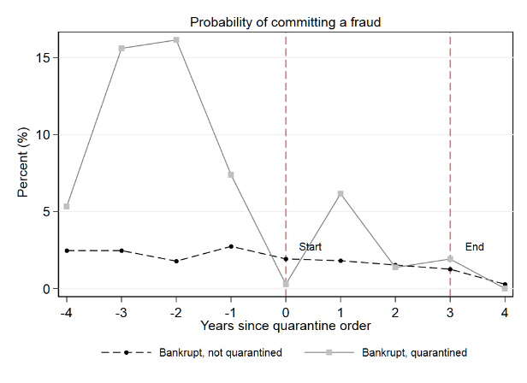
Effect on crimes: all crimes & frauds

Slide 21
Effect on crimes

Slide 22
Effect on managerial labor pool
Notes:
Changes in the characteristics of managers in the labor pool: ex-ante, anticipatory effect vs. ex-post effect of strawmen appointments

Slide 23
Effect on managerial labor pool
Disqualifications are costly for individuals
Individuals with criminal intentions may anticipate these costs and avoid having formal managerial responsibilities
Potential response to disqualification: appoint "straw men“
Identify characteristics associated with low cost of being disqualified from managing a business in Denmark
Foreigners
Individuals who receive public transfers

Slide 24
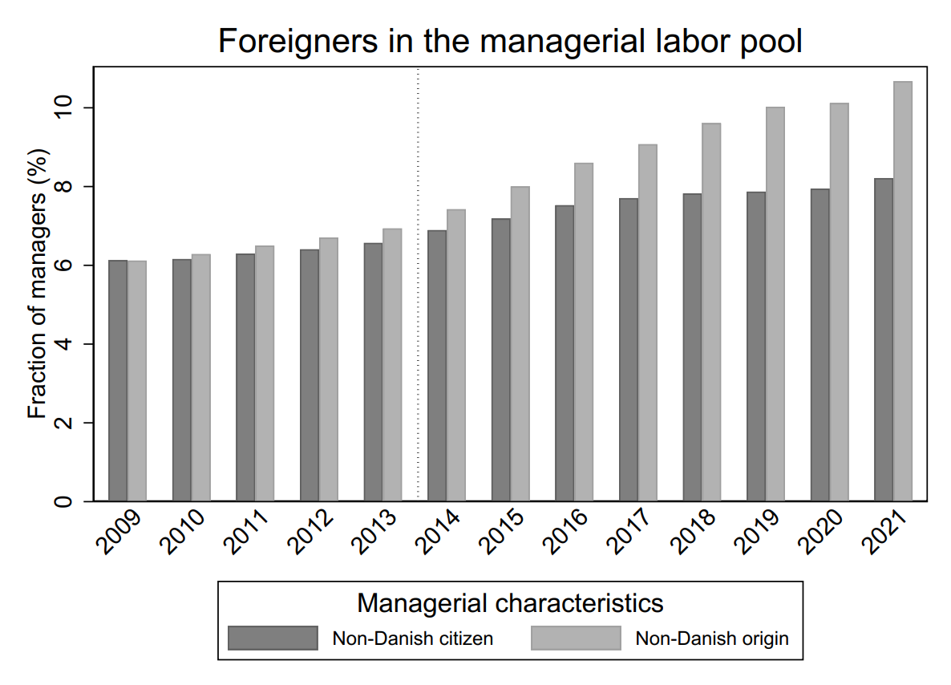
Effect on the managerial labor pool (1)

Slide 25
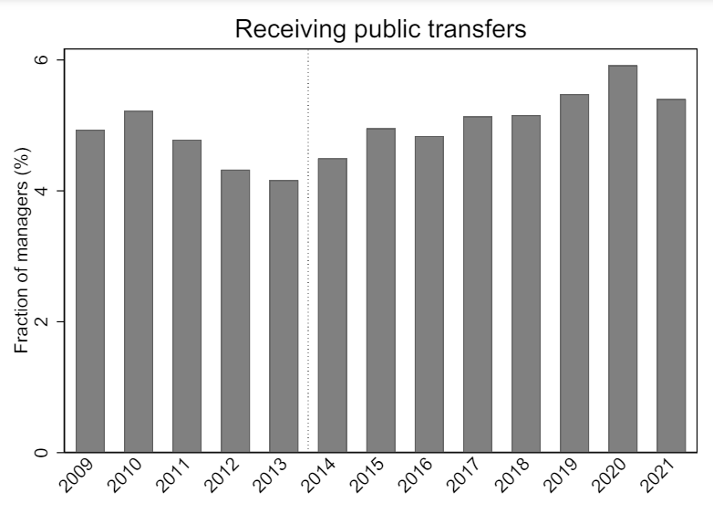
Effect on the managerial labor pool (2)

Slide 26
Effect on the managerial labor pool (3)

Slide 27
Conclusion
Personal deterrence from disqualification
20% lower income post-quarantine
Only 15% managerial comeback rate
Significant decline in future bankruptcies and criminal activities
Unintended consequences: strategic avoidance through strawman appointments
Family members in managerial positions increase from 10% to 30%
Shift in managerial labor pool composition
Increase in foreign citizens/origin
More managers receiving public transfers
(Groups with lower personal costs of disqualification)

Slide 28
Appendix

Slide 29
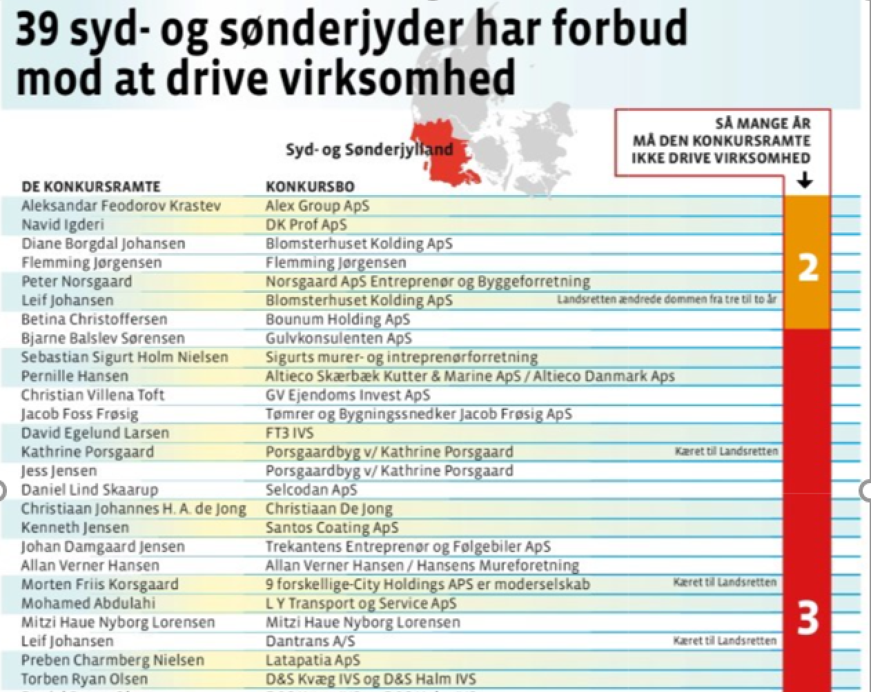
Example of quarantined managers
Notes:
Newspaper had access to quarantine register, through filing a freedom of information request to local bankruptcy courts. The Newspaper article provides the universe of the quarantined managers

Slide 30
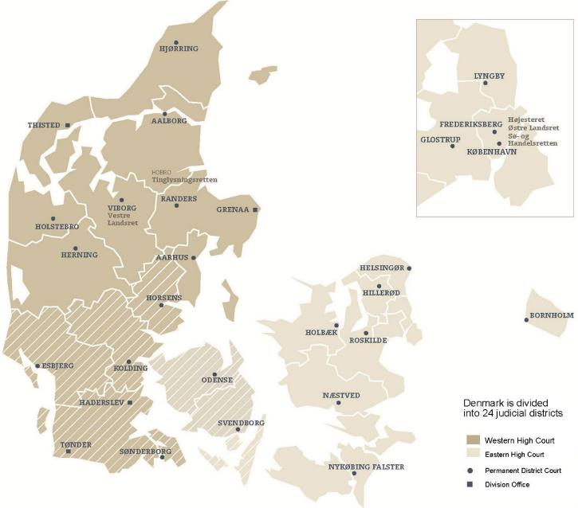
24 bankruptcy court districts in Denmark

Slide 31
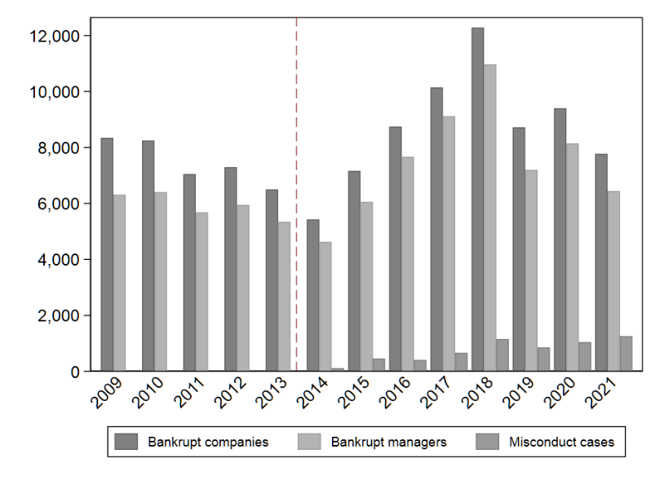
Number of bankruptcies and disqualifications

Slide 32
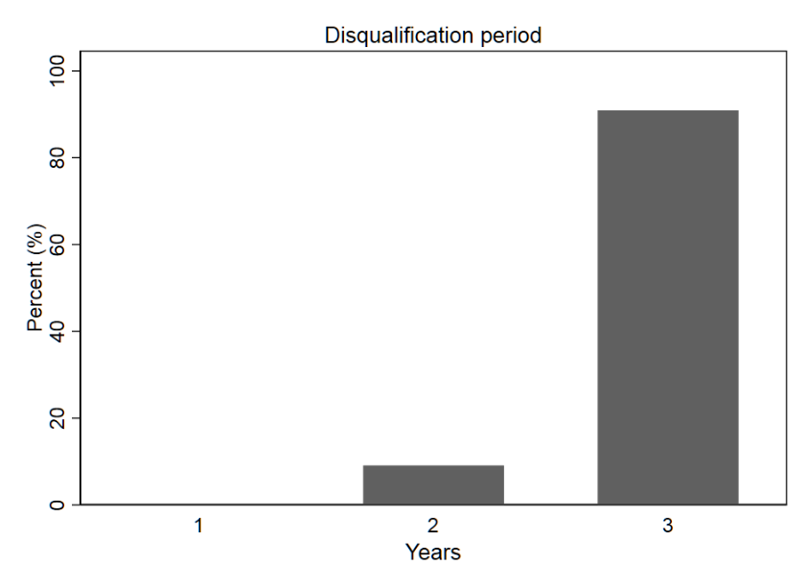
Length of disqualification period

Slide 33
Descriptive Statistics
Notes:
Measured at 2 years before quarantine order/bankruptcy ruling

Slide 34
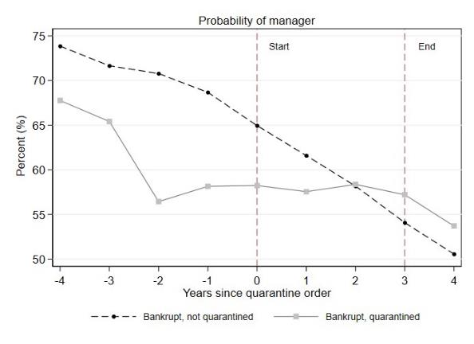
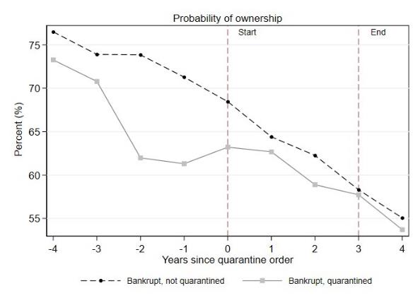
Effect on family appointment: children

Slide 35
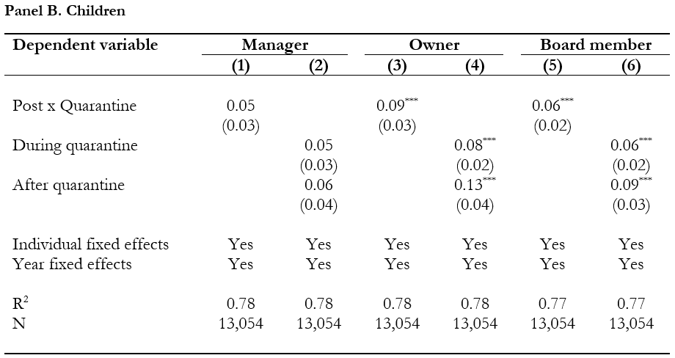
Effect on family appointments: children

Slide 36
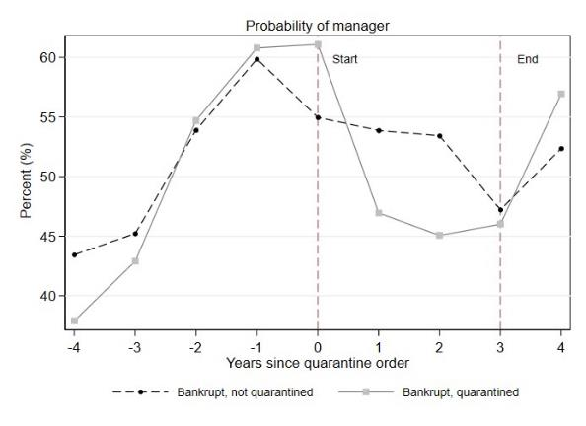
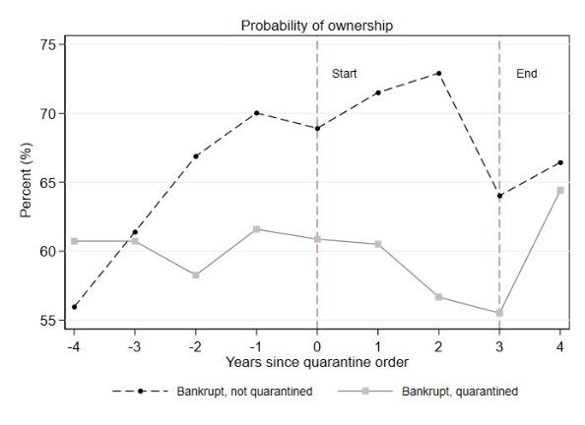
Effect on business network appointments
Notes:
Network: defined as anyone who had served in the management, ownership, or board at the same year in a company

Slide 37

Effect on business network appointments

Slide 38
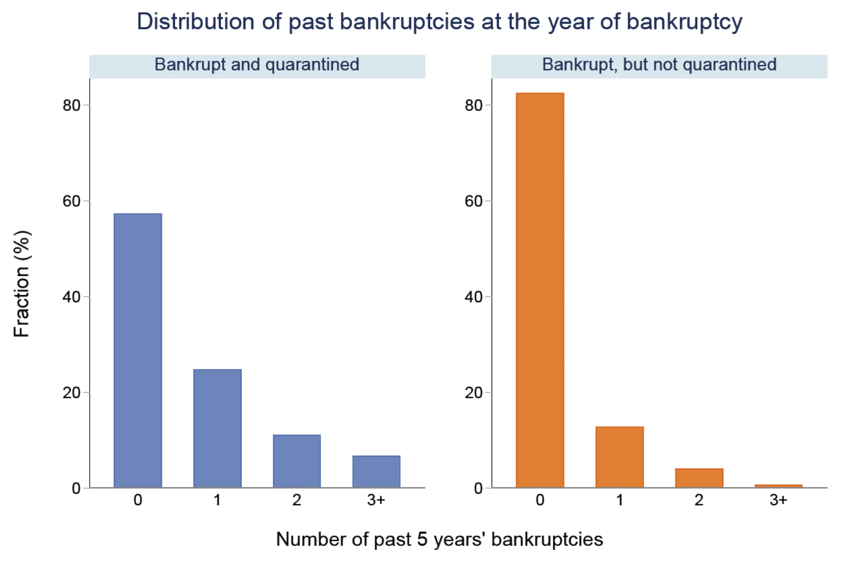
Incidence of prior bankruptcies

Slide 39
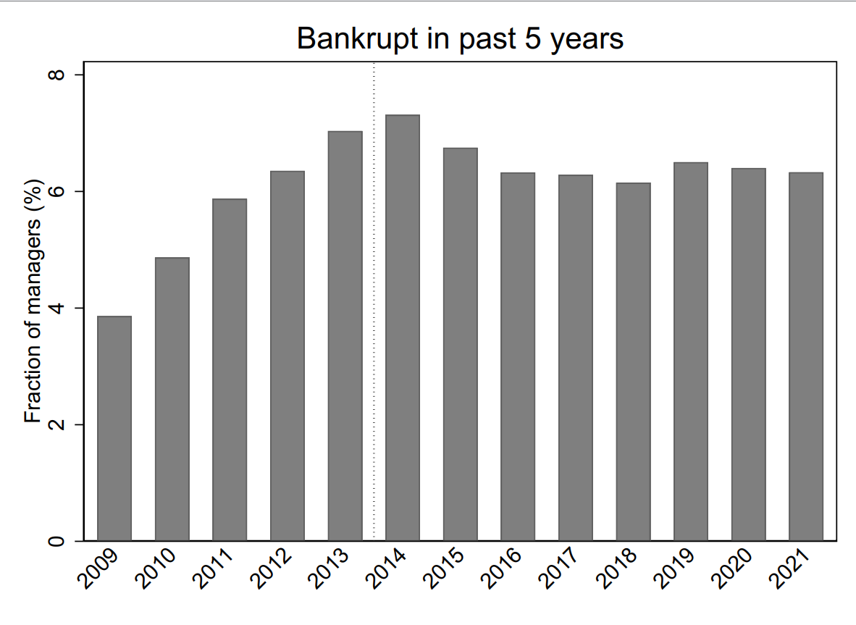
Effect on the managerial labor pool (4)

Slide 40
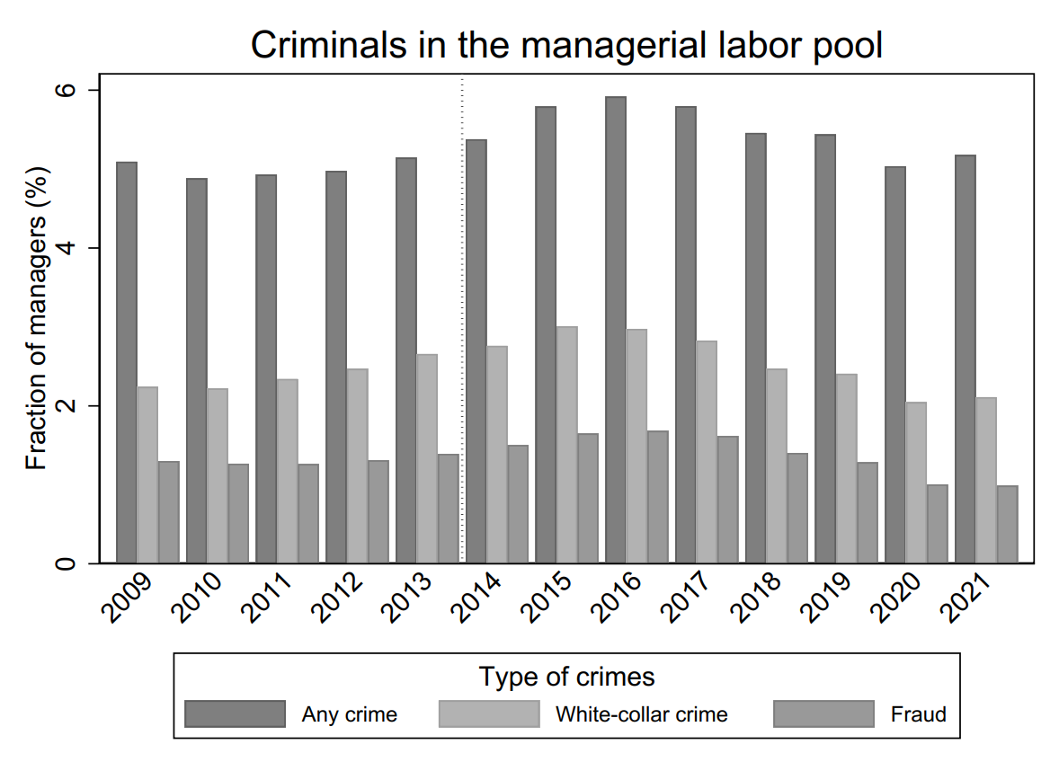
Effect on the managerial labor pool (5)

